Slide 1
Digital Image Processing
Labdhi Sheth

Slide 2
What do you mean by
Digital Image processing

Slide 3
Real world applications

Slide 5
Colour image processing
Wavelets and multiresolution processing
Compression
Morphological
processing
Image restoration
Knowledge base
Segmentation
Image filtering and
enhancement
Representation
& description
Image acquisition
Object
recognition

Slide 6
Colour image processing
Wavelets and multiresolution processing
Compression
Morphological
processing
Image restoration
Knowledge base
Segmentation
Image filtering and
enhancement
Representation
& description
Image acquisition
Object
recognition

Slide 7
Colour image processing
Wavelets and multiresolution processing
Compression
Morphological
processing
Image restoration
Knowledge base
Segmentation
Image filtering and
enhancement
Representation
& description
Image acquisition
Object
recognition

Slide 8
Colour image processing
Wavelets and multiresolution processing
Compression
Morphological
processing
Image restoration
Knowledge base
Segmentation
Image filtering and
enhancement
Representation
& description
Image acquisition
Object
recognition

Slide 9
Colour image processing
Wavelets and multiresolution processing
Compression
Morphological
processing
Image restoration
Knowledge base
Segmentation
Image filtering and
enhancement
Representation
& description
Image acquisition
Object
recognition

Slide 10
Colour image processing
Wavelets and multiresolution processing
Compression
Morphological
processing
Image restoration
Knowledge base
Segmentation
Image filtering and
enhancement
Representation
& description
Image acquisition
Object
recognition

Slide 11
Colour image processing
Wavelets and multiresolution processing
Compression
Morphological
processing
Image restoration
Knowledge base
Segmentation
Image filtering and
enhancement
Representation
& description
Image acquisition
Object
recognition

Slide 12
Colour image processing
Wavelets and multiresolution processing
Compression
Morphological
processing
Image restoration
Knowledge base
Segmentation
Image filtering and
enhancement
Representation
& description
Image acquisition
Object
recognition

Slide 13
Colour image processing
Wavelets and multiresolution processing
Compression
Morphological
processing
Image restoration
Knowledge base
Segmentation
Image filtering and
enhancement
Representation
& description
Image acquisition
Object
recognition

Slide 14
Colour image processing
Wavelets and multiresolution processing
Compression
Morphological
processing
Image restoration
Knowledge base
Segmentation
Image filtering and
enhancement
Representation
& description
Image acquisition
Object
recognition

Slide 15
Sampling and quantization:
The output of most sensors is a continuous voltage waveform whose amplitude and spatial behavior are related to the physical phenomenon being sensed. To create a digital image, we need to convert the continuous sensed data into digital form.
This involves two processes: sampling and quantization.
An image may be continuous with respect to the x- and y-coordinates, and also in amplitude.
To convert it to digital form, we have to sample the function in both coordinates and in amplitude.
Digitizing the coordinate values is called sampling.
Digitizing the amplitude values is called quantization.

Slide 16
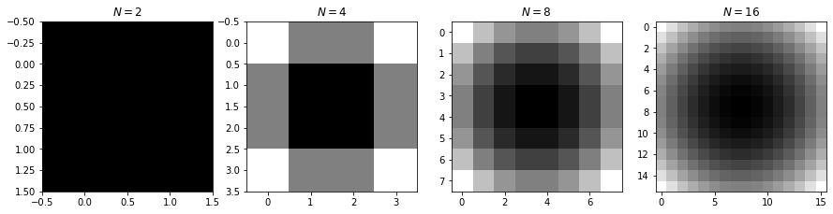
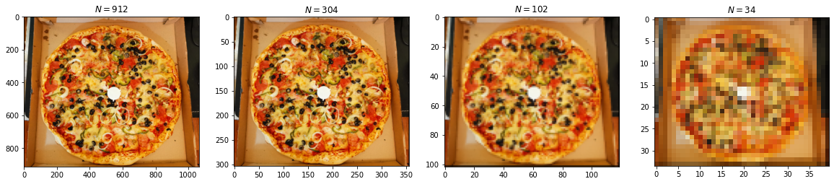
Sampling:

Slide 17
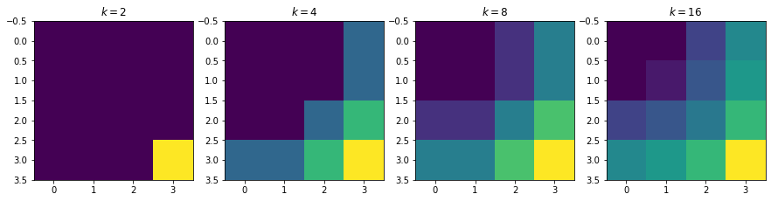
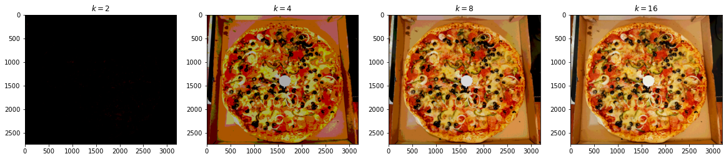
Quantization:

Slide 18
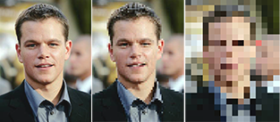
Resolution:

Slide 19
Neighbours:
(x-1,y-1) | (x-1,y) | (x-1,y+1)
(x,y-1) | (x,y) | (x,y+1)
(x+1,y-1) | (x+1,y) | (x+1,y+1)
(x-1,y-1) | (x-1,y) | (x-1,y+1)
(x,y-1) | (x,y) | (x,y+1)
(x+1,y-1) | (x+1,y) | (x+1,y+1)
(x-1,y-1) | (x-1,y) | (x-1,y+1)
(x,y-1) | (x,y) | (x,y+1)
(x+1,y-1) | (x+1,y) | (x+1,y+1)

Slide 20
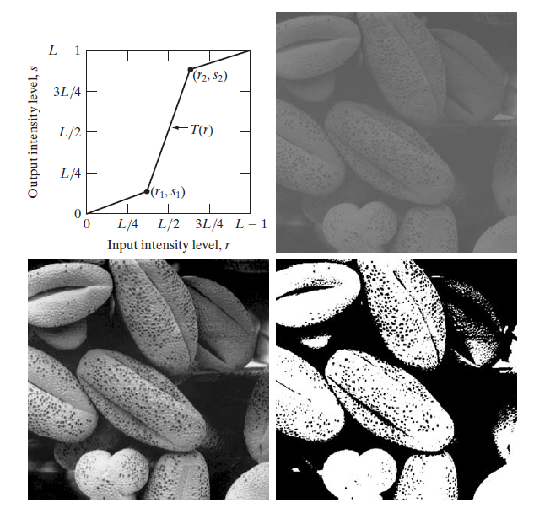
Image enhancement:
Intensity transformations:
Contrast stretching
Thresholding

Slide 21
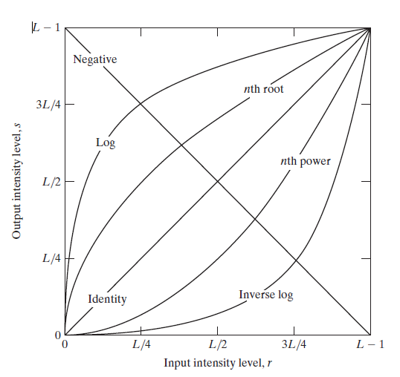
Image enhancement:
Basic intensity transformation function
Linear – negative and identity
Logarithmic – log and inverse log
Power law – nth power and nth root

Slide 22
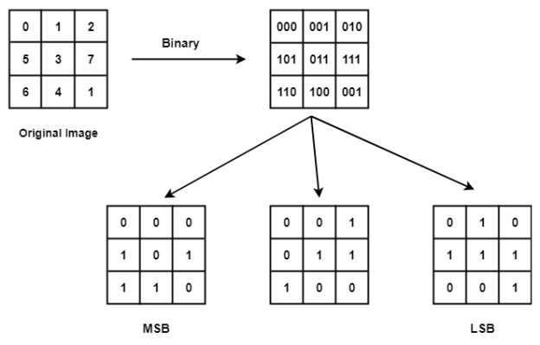
Image enhancement:
Bit plane slicing
Pixels are represented in form of bits
0-255 thus 8 bits are used
Instead of highlighting the intensity we highlight the contribution of bits
MSB – visual significant data
LSB – fine details

Slide 23
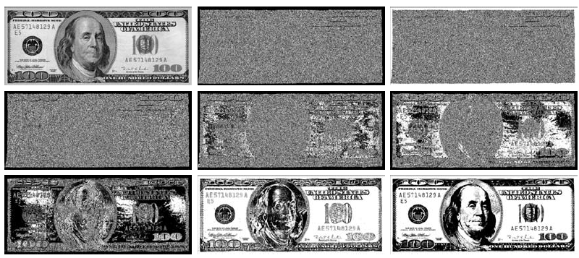
Image enhancement:

Slide 24
Image smoothing:
By smoothing an image prior to applying techniques such as edge detection or thresholding we are able to reduce the amount of high-frequency content, such as noise and edges.
Normalized blur
Median blur
1 | 2 | 3
4 | 12 | 9
45 | 56 | 16

Slide 25
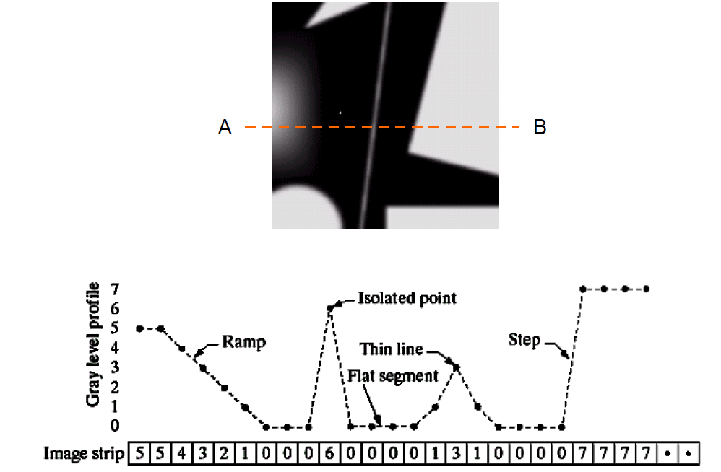
Image sharpening:
It seeks to highlight the fine details by removing the blurring and highlighting the edges. Sharpening function is based on spatial differentiation.

Slide 26
Image sharpening:
First order derivative filter output
Zero at areas of constant grey level intensities.
Non zero at the onset of a grey level step or ramp.
Non zero along ramps.
δf/ δx = f(x+1)-f(x)
Second order derivative filter output
Zero at areas of constant grey level intensities.
Non zero at the onset and end of a grey level step or ramp.
Zero along ramps of constant slope.
δf/ δx = f(x+1) + f(x-1) – 2f(x)

Slide 27
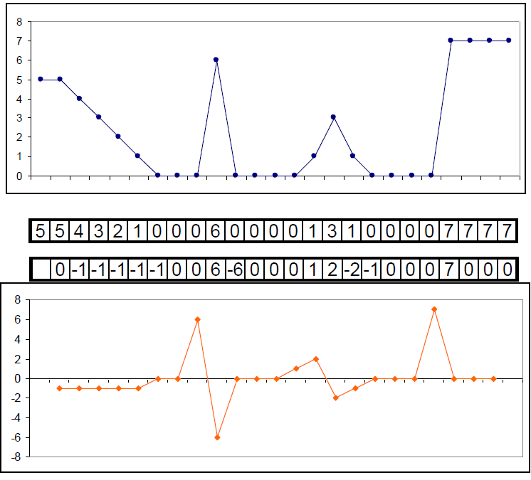
Image sharpening:

Slide 28
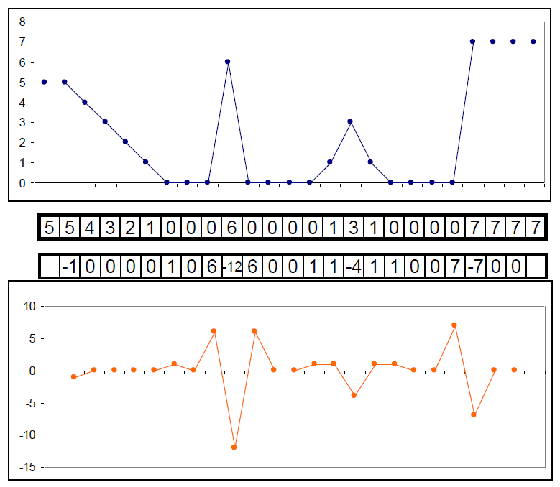
Image sharpening:

Slide 29
Image sharpening:
Laplacian filter:
Unsharp operation:
Blur the image
Subtract it from the original image
Add mask to the resulted image
0 | -1 | 0
-1 | 4 | -1
0 | -1 | 0
-1 | -1 | -1
-1 | 8 | -1
-1 | -1 | -1

Slide 30
Colour fundamentals:
Radiance: the total amount of energy that flows from the light source
Luminance: the amount of energy an observer perceives from the light source
Brightness: a subjective notion that embodies the achromatic notion of intensity of light

Slide 31
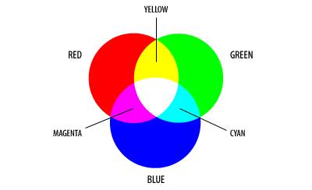
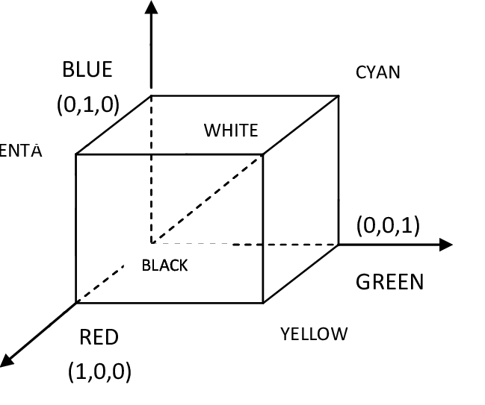
RGB Model:
Brightness
Hue
Saturation
Hue and saturation are called chromaticity.

Slide 32
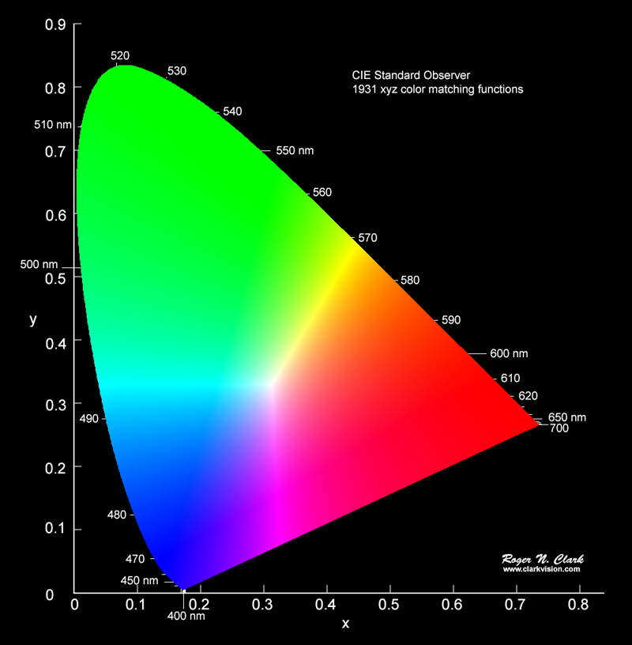

Chromaticity diagram:
It is a 2-D diagram where x-axis represents the portions of red and y-axis represents portions of green.

Slide 33
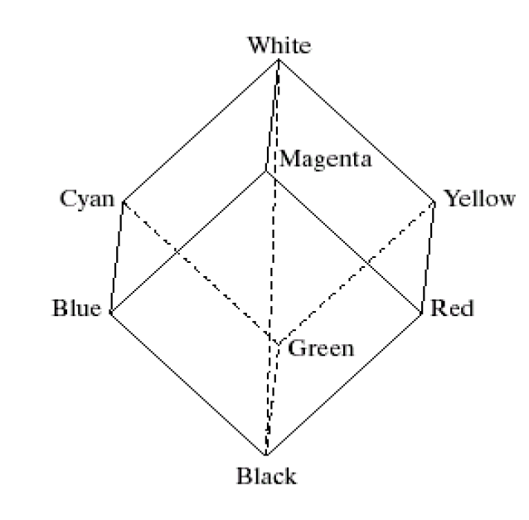
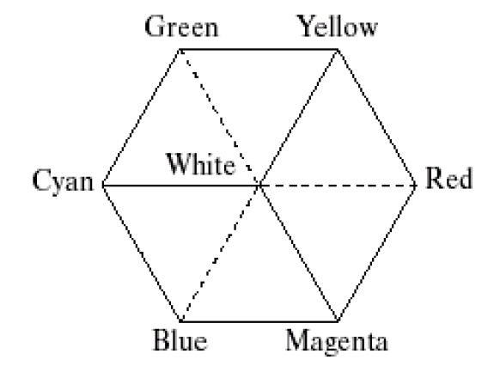

HSI model:
Hue: purity of the color
Saturation: how much is a pure color diluted with white color
Intensity: brightness is almost impossible to measure thus we calculate intensity. Intensity is the same achromatic notion as seen in grey level images.

Slide 34
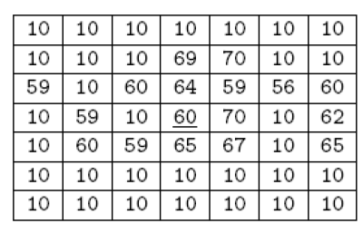

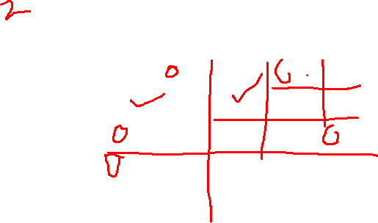
Image segmentation:
Discontinuity based approach
Similarity based approach
5 | 6 | 4 | 7 | 4
5 | 5 | 3 | 6 | 7
7 | 6 | 3 | 3 | 2
1 | 6 | 6 | 4 | 4
3 | 2 | 5 | 6 | 4

Slide 35
THANK YOU

